Slide 1

Lecture 2

Slide 2
Recap
Learning
Supervised Learning
Unsupervised Learning
Reinforcement Learning

Slide 3
Topics to be covered
Linear Regression
Weights and Features
Applications
Cost Functions
Finding best fit line

Slide 4
What is Regression?
Supervised learning algorithm.
Consists of one or more feature values and a corresponding single output value.
Output is a continuous value.
Learns the line, plane or hyperplane that best fits the training samples.

Slide 5
Regression
Regression shows a line or curve that passes through all the data points on a target-predictor graph in such a way that the vertical distance between the data points and the regression line is minimum

Slide 6
Linear Regression
Linear Model: assumes linear relationship between input variables (x) and a single output variable (y).
Simple Linear Regression: single input variable (x).
Multiple Linear Regression: multiple input variables (x₁, x₂,…,x_{n}).

Slide 7
Linear Regression
Given an input x we would like to compute an output y
For example:
- Predict height from age
- Predict Google’s price from Yahoo’s price
- Predict distance from wall from sensors
y
x

Slide 8
Linear Regression
In linear regression we assume that y and x are related with the following equation:
y = b0+b1.x+ε
where ‘b0’ is a intercept at y-axis, ‘b1’ is slope of line, ‘ε’ represents error in measurement or other noise
What we are trying to predict
Feature values
y
x

Slide 9
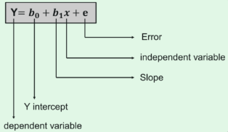
Linear Regression
The dependent variable that is to be predicted is denoted by Y.
A line that touches the y-axis is denoted by the intercept b₀.
b₁ is the slope of the line, x represents the independent variables that determine the prediction of Y.
The error in the resultant prediction is denoted by e.

Slide 10
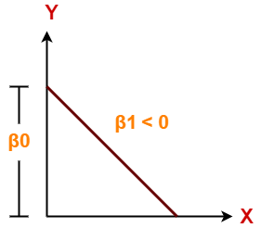
Case 1
It indicates that variable X has negative impact on Y.
If X increases, Y will decrease and vice-versa.

Slide 11
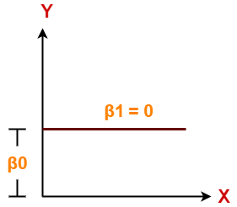
Case 2
It indicates that variable X has no impact on Y.
If X changes, there will be no change in Y.

Slide 12
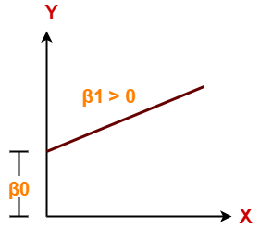
Case 3
It indicates that variable X has positive impact on Y.
If X increases, Y will increase and vice-versa.

Slide 13
What is Cost Function?
A Cost Function is used to measure just how wrong the model is in finding a relation between the input and output. It tells you how badly your model is behaving/predicting

Slide 14

Cost Function
The cost function provides the best possible values for b₀ and b₁ to make the best fit line for the data points.
We do it by converting this problem into a minimization problem to get the best values for b₀ and b₁.
The error is minimized in this problem between the actual value and the predicted value.

Slide 15
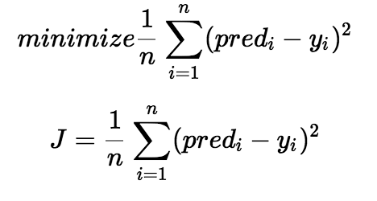
It is also known as MSE(Mean Squared Error), and we change the values of b₀ and b₁ so that the MSE value is settled at the minimum.

Slide 16
Applications of Linear Regression
Sales Forecasting
Risk Analysis
Housing Applications To Predict the prices and other factors
Finance Applications To Predict Stock prices, investment evaluation, etc.

Slide 18
